Slide 1
Statistical Workshop on the Raising Procedures for Med&BS Biological data 16 January 2025
Methodological Approaches of Cyprus
Charis Charilaou & Ioannis Thasitis

Slide 2
Introduction
Department of Fisheries and Marine Research (DFMR)
The national authority of Cyprus responsible for the management of fisheries resources, implementation of the Common Fisheries Policy and the protection and conservation of the marine environment.
DFMR Fisheries Resources Division
Responsible for all aspects of the implementation of the EU Data Collection Framework (collection, management and use of fisheries data)
DFMR Control Division
Responsible for the implementation of national and EU Fisheries Law, including Control Regulation (Regulation (EC) 1224/2009 and Implementing Regulation (EU) 404/2011)

Slide 3
Control Data used for DCF purposes
Landings and effort data through logbooks for vessels ≥ 10m (concerns part of small-scale fleet, the polyvalent fleet involved in large pelagic and demersal fishery and the trawlers). Available at fishing operation (haul) level by fishing trip in Electronic Reporting System (ERS).
Landings data through sales notes and sales receipts for all licensed vessels (by vessel, port/landing site, landing day). Available in ERS.
No threshold applied for reporting landings; all quantities should be reported.
For vessels <10m assumption that 1 sales note = 1 fishing trip = 1 fishing day=day at sea. No information on the fishing gears used.
VMS data (currently not covering small-scale fleet)

Slide 4
Concerns on the quality of control data used for DCF purposes
Landings recorded in logbooks and sales notes may not include all species (high number of species landed with very low quantities --- > grouped in landings recording the main species)
Polyvalent fishing activity, where more than one type of gear is used during a single trip, is very common. Not all gears may be recorded in logbooks.
Coordinates recorded in logbooks by fishing operation may not always be accurate

Slide 5
Estimation of effort variables from e-logbooks
Fishing days, days at sea, no. of trips estimated using R-scripts developed during the 2nd Workshop on Transversal Variables (Nicosia, Cyprus, 22-26 February 2016
https://publications.jrc.ec.europa.eu/repository/handle/JRC101362)
Plan to further review the work conducted by the Pan-regional ISSG on Métier and transversal variables and make adjustments as needed.

Slide 6
Fishing activity variables data collection strategy_1
Information on data collection strategy for the collection of fishing activity variables included in Text Box 3.1 of Cyprus WP 2025-2027
Complementary data collection is required for small scale vessels
For collecting certain effort variables (e.g. length of nets, number of hooks, soaking time)
For assigning fishing effort to metiers
For assigning landings to metiers

Slide 7
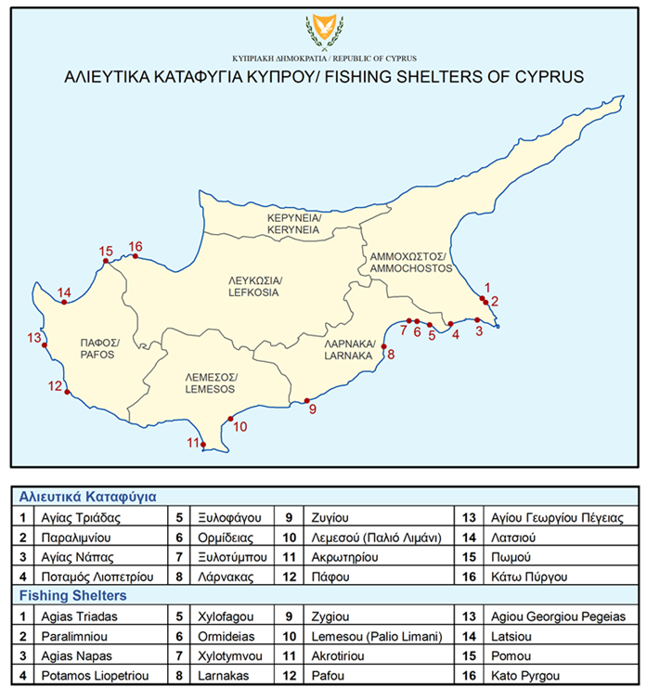
Fishing activity variables data collection strategy_2
Complementary data on effort and landings by metier is collected through a probability sample survey.
PSU= the landing site on a given day, selected randomly four times per week
SSU= the cluster of trips within the PSU, aiming to sample all vessels that land from morning until midday, which is the landing time for most of fishermen.
For each sampled trip: data on métiers and quantities of gears used are recorded, as well as all quantities of species, assigned to each métier.
This probability sample survey takes place as part of the biological sampling.

Slide 8
Fishing activity variables data collection strategy_3
Complementary data collection on landings
Applies to active vessels using passive gears with no logbook data.
Aim: to estimate the percentage of landings for each species assigned to each métier.
This percentage is raised to the total landings (derived from data collected under Control Regulation), enabling the estimation of species-specific landings by métier.

Slide 9
Fishing activity variables data collection strategy_4
Complementary data collection on effort
Aim: to estimate the % of fishing days, days-at-sea, fishing trips and fishing operations assigned to each métier for active vessels using passive gears without logbook data.
If multiple métiers are exercised on a fishing day, one fishing day, day-at-sea, fishing trip, or fishing operation is assigned to each métier involved.
This percentage is then raised to the total number of fishing days/ days-at-sea/ fishing trips/fishing operations (estimated from number of sales notes and sales receipts collected under Control Regulation), allowing the estimation of these effort variables by métiers.
Based on data collected on length of nets, number of hooks, number of pots and soaking time, an average value for these variables is estimated per métier, and is raised to the total number of fishing days by métier.

Slide 10
Estimation of discards_1
Discard data collected mainly during onboard sampling, as part of biological sampling (only in GSA25)
Occasionally discard samples from OTB collected by the crew and provided to the DCF team, following communication
Discard ratio: Calculated based on the 2019 GFCM manual for Monitoring discards in Mediterranean and Black Sea fisheries
According to the manual:
“The ratio estimator of discards (R) for a given species in a given stratum is estimated on the sampling data and can be estimated by dividing the discarded amount (D) of the species in the stratum (e.g. fleet segment, fleet segment-quarter) by the amount of all retained commercial species (landed fraction, L) in the stratum S”

Slide 11
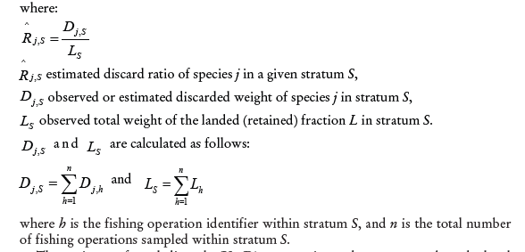
Estimation of discards_2
Based on GFCM manual:

Slide 12
Estimation of discards_3
Other discard raising procedures we apply: Raising by fishing days / fishing operations
Should the Group agree on a Discard Raising Procedure Guide?
Should the Group consider applying different raising procedures and compare the resulting discard estimates?

Slide 13
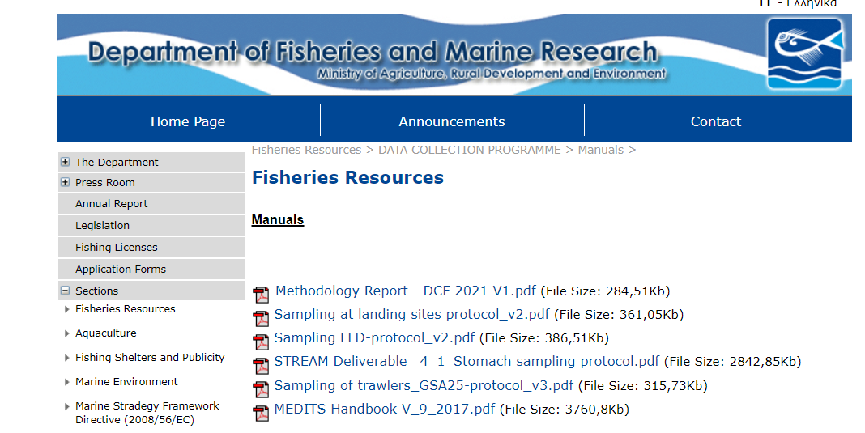
Biological Data Sampling Schemes
Sampling Schemes used for different fisheries as outined in Annex 1.1 of WP 2025-2027
Available also at DFMR website: https://www.moa.gov.cy/moa/dfmr/dfmr.nsf/All/A22B9A733AB6CF3242258330002187A3?OpenDocument

Slide 14
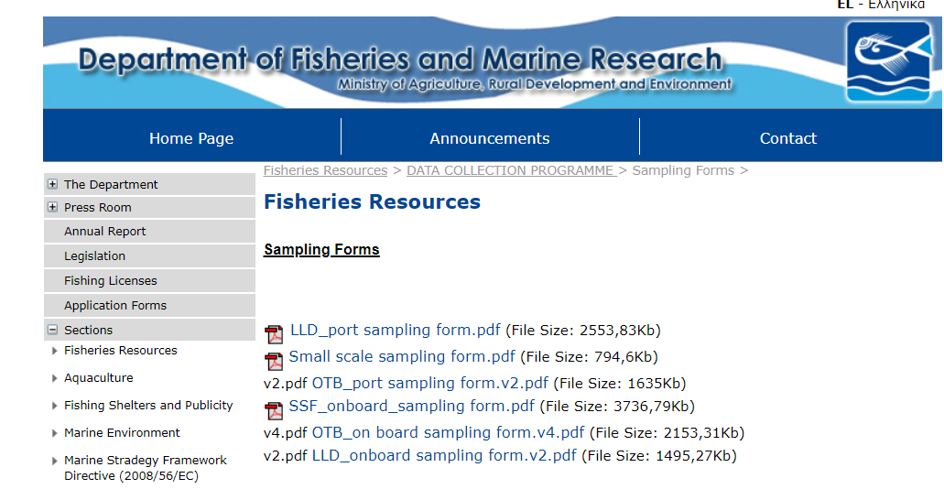
Biological Data Sampling Schemes_2
Sampling forms used are available at: https://www.moa.gov.cy/moa/dfmr/dfmr.nsf/All/5C667104B416A5A0C22586C500320E18?OpenDocument

Slide 15
Estimation of Length Frequency Distribution – LFD_1
Length data collected for a number of species by trip/gear/quarter, based on sampling schemes. Each sampled trip is assigned a unique sampling ID; all samples taken are linked with the sampling ID.
Based on the different sampling schemes, length data collected concurrently either at landing sites at trip level, or onboard at haul level
All length samples by trip/gear/quarter are summed and raised to total landings of gear/quarter. Length samples are not raised to the sampled trips. Sampling weight is recorded, and is corrected based on L-W estimates, in the case age distribution is estimated for the species.
Should the group decide on a rule for raising length samples to the sampled trips? E.g. set a minimum sampled number based on size range of species and/or a minimum % of sample size?

Slide 16
Estimation of LFD_2
In the case of OTB samples:
Certain species are landed in different commercial categories. Species landings data by commercial category are available at the trip level (provided by fishmonger=vessel owner upon request) and at haul level by onboard observers.
Length sample of each commercial category is raised to the weight of the commercial category (either at trip/ haul level). Then all raised samples are summed and are raised to total landings by quarter.
Issue: when length samples of each commercial category are raised at the trip level, they drive the LFD, compared to length samples raised at haul level. Should we consider applying a ratio among commercial categories at trip level for raising length samples?
Missing commercial categories: In cases where observers cannot access all commercial categories for length sampling but have relevant landings data, assumptions are made to estimate the missing length samples.

Slide 17
Estimation of Age Frequency Distribution
Age data are collected for 5 demersal species, based on sampling schemes. Biological samples (for age and other biological data) are obtained from length samples (through length-stratified sub-sampling)
In some cases, biological samples are collected whenever available by fishermen /fishmongers, based on availability and demand (e.g. for MUR) .
ALK prepared from direct age readings (1 ALK at annual level)
Numbers at age by gear/quarter calculated using ALK and LFD

Slide 18
Estimation of other biological variables
Biological samples collected are the same used for age data
Use of analytical and boostrap methods (e.g. inbio software by Spanish colleagues)
For estimating maturity ogive, only samples collected during the reproduction season are used. Annual biological data from commercial sampling may be insufficient, and may be combined with data from Medits survey and/or data from previous year (e.g. MUR).
Difficulties arise with hermaphrodite species (PAC, SPC)

Slide 19
Anticipations with the use of RDBFIS in Raising Procedures
Opportunity to apply different raising and estimation methods
Establishment of common rules? (e.g. on sampling coverage, how to deal with missing data) for ensuring coordination and comparability of estimates
Improved quality of biological estimates

Slide 20
THANK YOU
FOR YOUR ATTENTION

